Slide 1
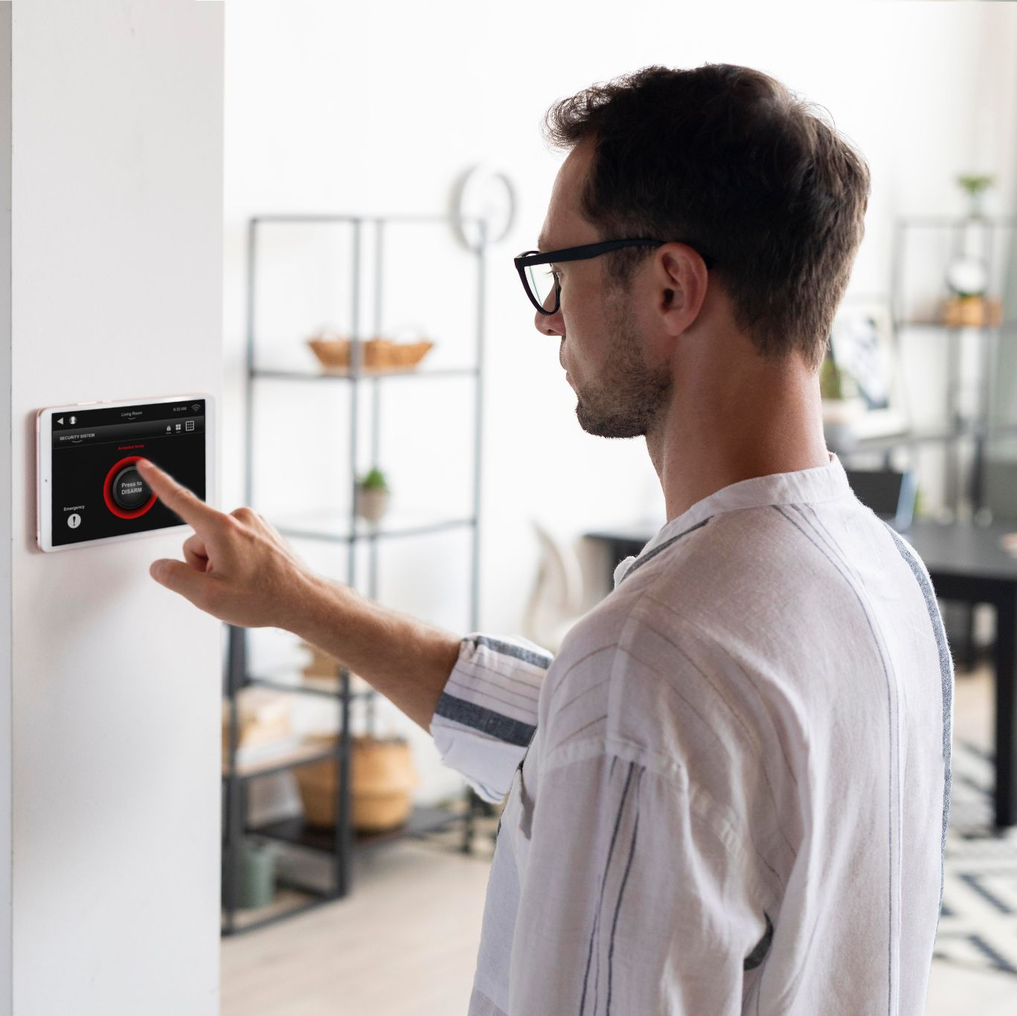
SMART HOME SMART Garage PROJECT

Slide 2
Ahmed Dawood Mohamed 20221454408 Omar Gamal Abd-ElAziz 20221446135 Ahmed Ehab EL-sayed 20221445838 Ahmed Yousri Ali 2103108 Fares Hazem Mohamed 20221443356

Slide 3
CONTENT OF THIS PROJECT
Introduction to Smart Home
The convergence of technology and modern living has given rise to the concept of smart homes, transforming traditional living spaces into intelligent, automated environments.
Our project focuses on developing a comprehensive smart home system that integrates cutting-edge technologies to enhance comfort, security, energy efficiency, and overall quality of life.
Leveraging IoT (Internet of Things) devices, sensors, and advanced connectivity, our smart home project aims to create an interconnected ecosystem where devices seamlessly communicate and respond to user preferences.
This project extends beyond individual devices, aiming to create a cohesive and holistic smart environment that adapts to residents' needs and routines.

Slide 4
Through a user-friendly mobile app interface, residents can remotely manage , access and monitor various aspects of their home, such as lighting, Fan control, entertainment systems , and sensors for safety
The energy efficiency aspect of our project contributes to sustainable living. The smart home system monitors energy consumption, suggesting ways to minimize waste and reduce utility costs.
Collaborating with architects and interior designers, our project seamlessly integrates smart technologies into the aesthetics of the home, maintaining a balance between functionality and style.
In essence, our smart home project envisions a future where technology enhances daily living, simplifying tasks, personalizing experiences, and providing a higher level of convenience .

Slide 5
Introduction to IoT-Based Smart Garage Project Automated Parking Solution
In urban environments where parking space is increasingly scarce and managing vehicle congestion is a challenge, the concept of a Smart Garage utilizing the Internet of Things (IoT) has emerged as a transformative solution. This innovative approach integrates cutting-edge technologies to efficiently manage and optimize parking spaces within a garage, providing a seamless experience for both drivers and facility managers.
The core idea of the IoT-based Smart Garage project is to create a fully automated parking system that enables vehicles to locate and occupy available parking spaces without human intervention. This addresses the frustrations associated with circling around for parking spots and contributes to reduced traffic congestion and emissions in urban areas

Slide 6
TABLE OF CONTENTS
01
Phisical Environment
03
Cloud & FireBase
UI Application
02
04
Features

Slide 7
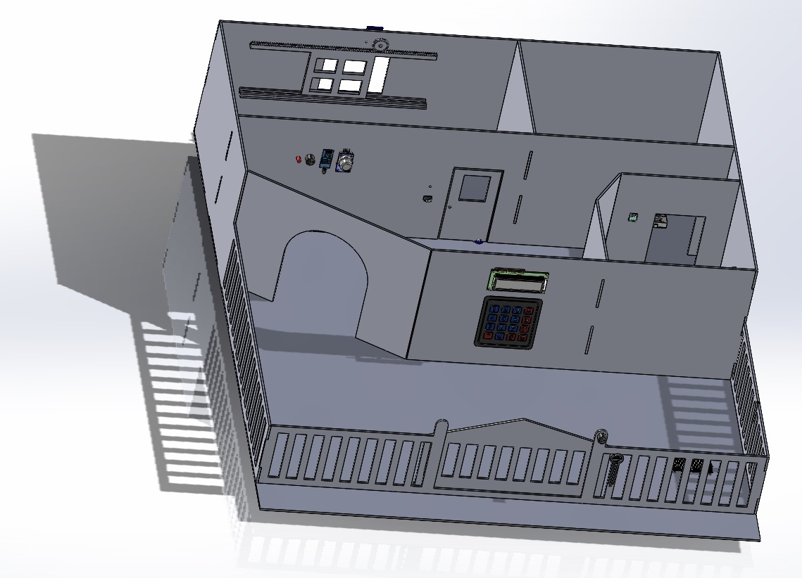
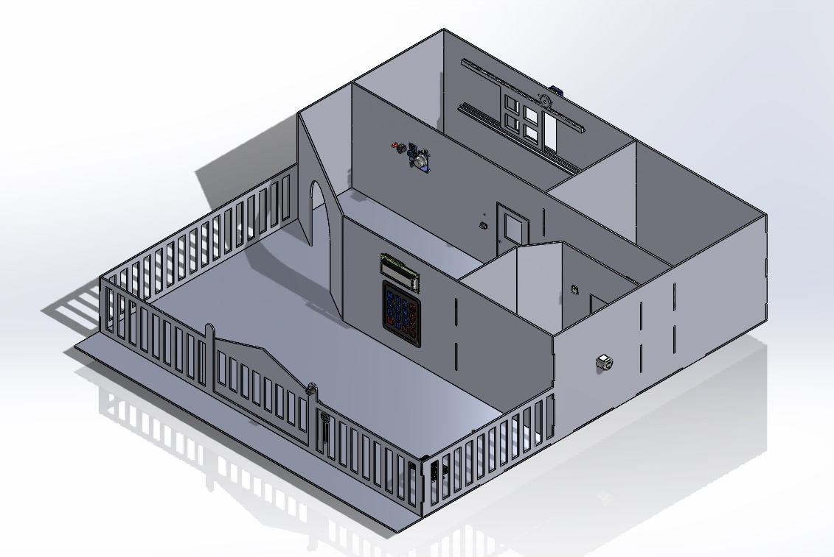
Solid Work Smart Home
01

Slide 8
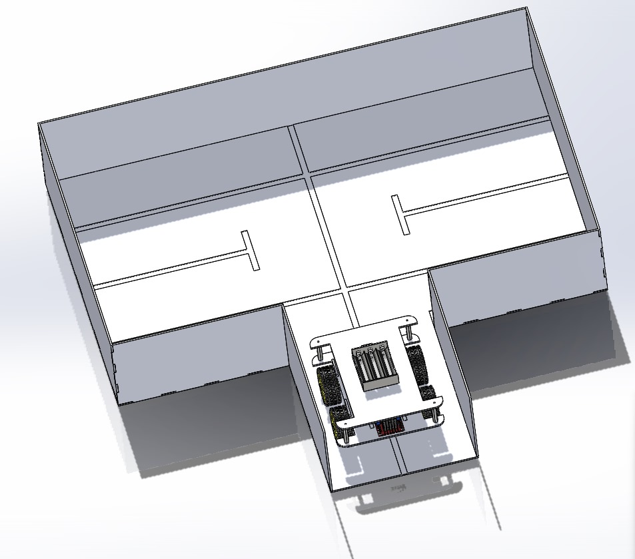
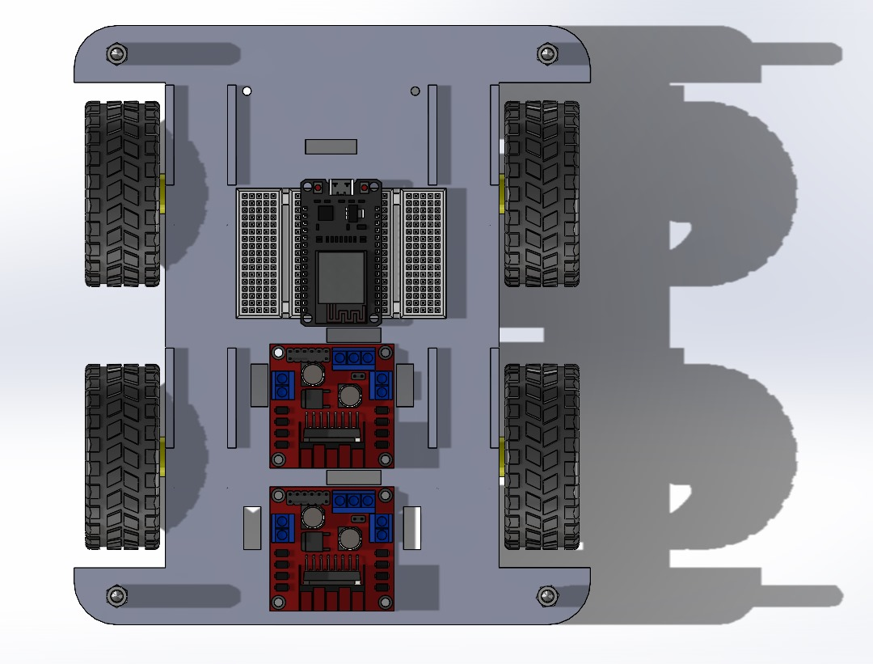
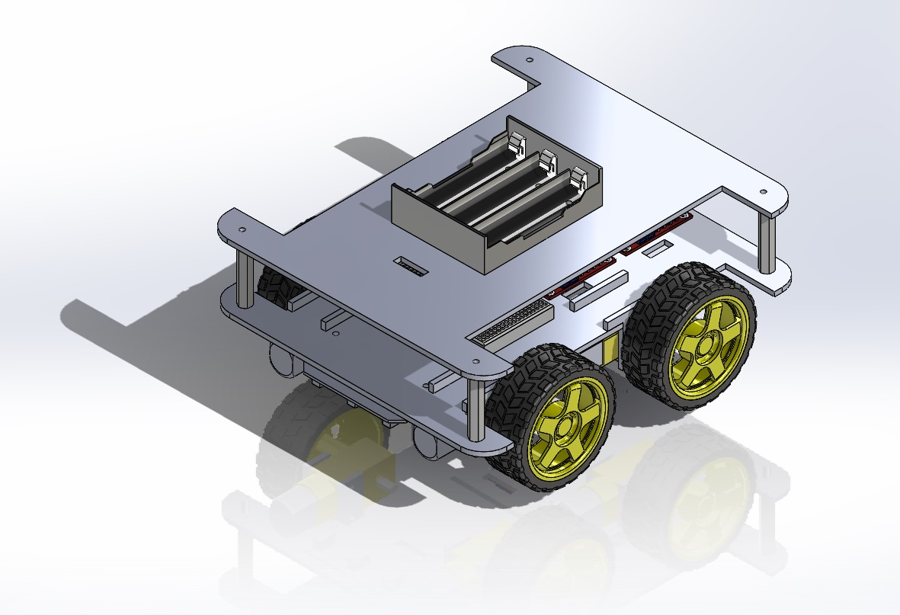
Solid Work Garage

Slide 9
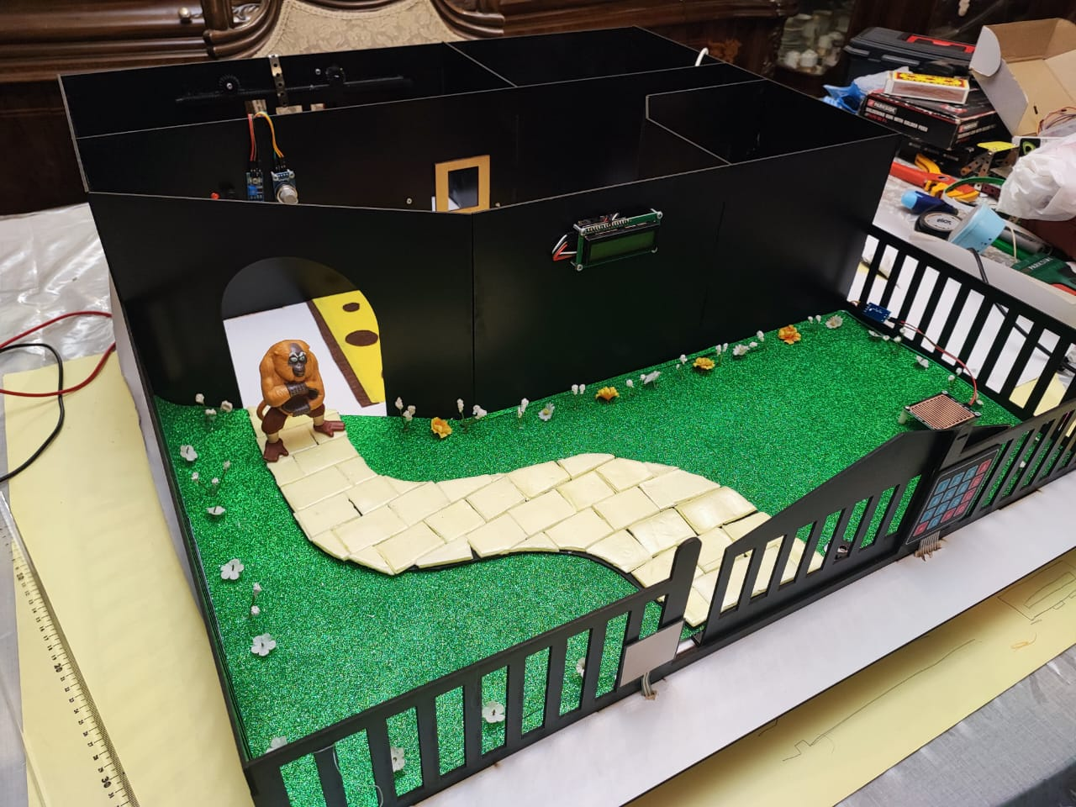
Security System with Keypad and LCD
02
Diving into security, we present our comprehensive system with a keypad and LCD display. The keypad allows residents to input a password for access control. The system instantly validates the password and displays a corresponding message on the LCD, granting or denying entry

Slide 10

Bell System with Force Sensor and Buzzer
with our innovative bell system, featuring a force sensor and a buzzer. This system transforms the way we announce visitors. By pressing the force sensor, a signal is sent, activating the buzzer—functioning just like a traditional doorbell but with a modern twist.

Slide 11
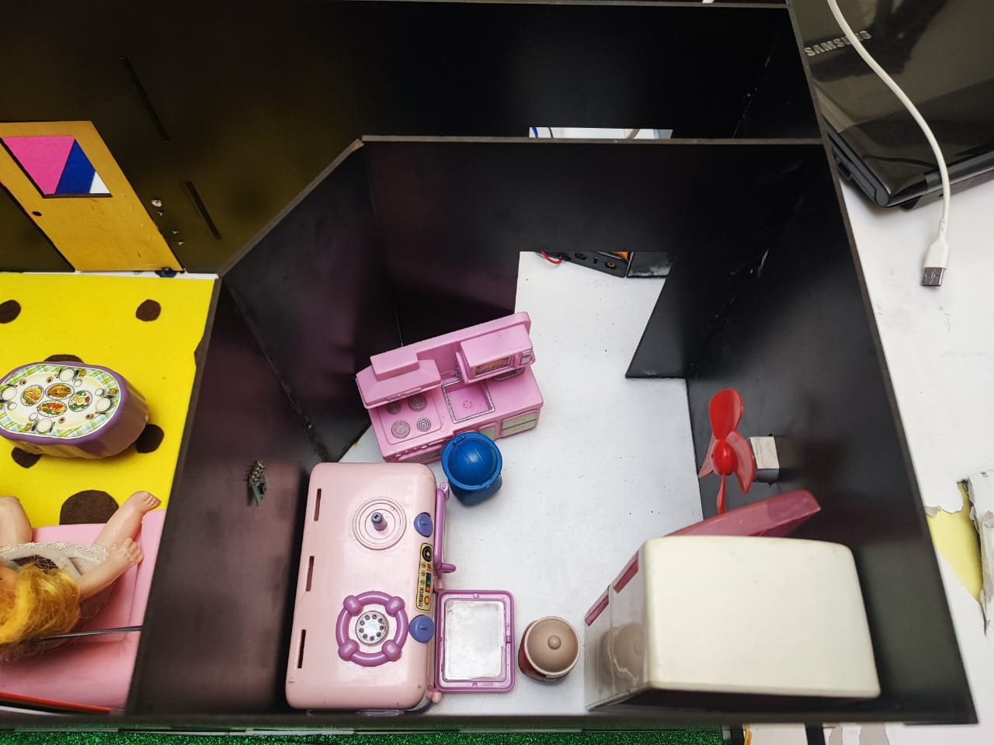
Automated Fan Control using Temperature Sensor
Our project extends to automated climate control through a temperature sensor. This sensor continuously monitors room temperature. If the temperature crosses a predefined threshold—let's say, 32°C—the system activates a fan, ensuring a comfortable living space without manual intervention.

Slide 12
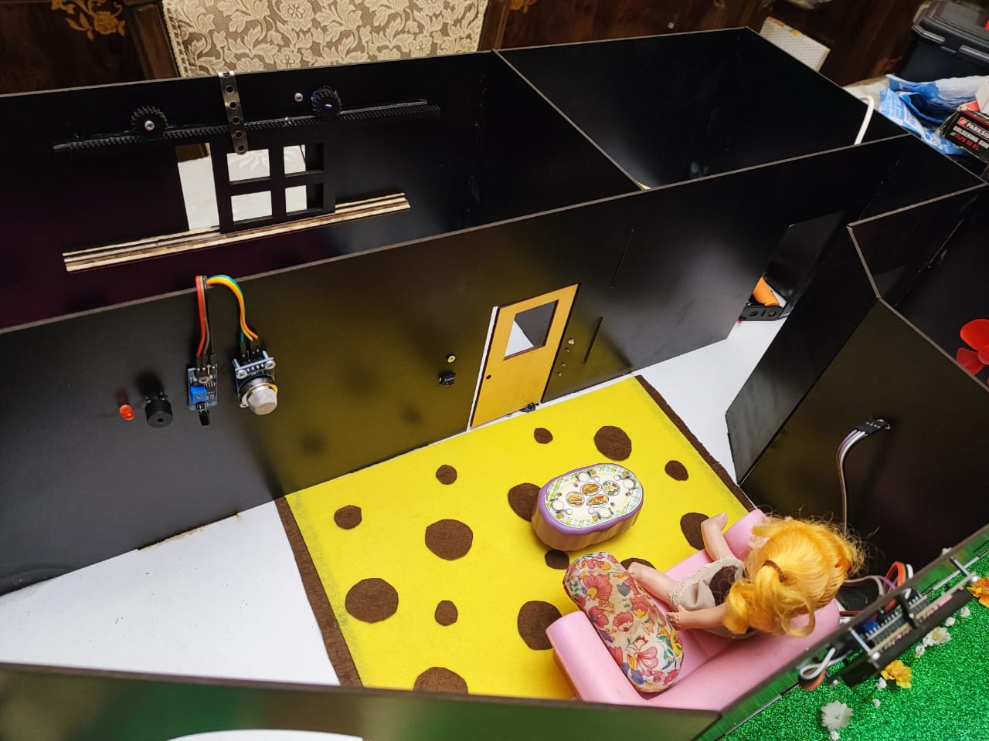
Alarm System with Buzzer and LED using Flame and Smoke Sensors
we introduce our advanced alarm system, equipped with both a buzzer and LED indicators. The integration of flame and smoke sensors ensures that any sign of fire or smoke triggers a dual response. The buzzer alerts occupants, while the flashing LED captures immediate attention, enhancing safety measures

Slide 13
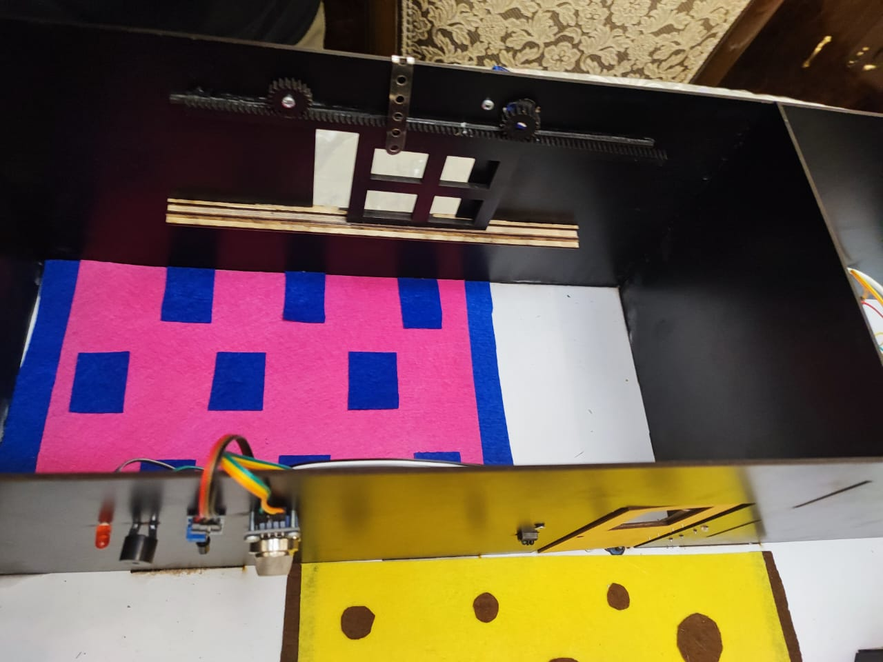
Automatic Door Opening with IR Sensor
our automatic door opening system, driven by an IR sensor. When an object is detected in proximity, such as a person approaching the door, the system responds by automatically opening the door for a convenient 5-second window

Slide 14
Smart Garage
The IoT Smart Garage and Car Automation project. Today, we'll explore how cutting-edge technology can revolutionize parking through seamless integration of sensors, apps, and smart systems.
1. Smart Garage with IR Sensor :
Our project begins with a Smart Garage featuring four parking spaces. At the heart of this system lies an IR sensor network that detects the availability of parking spaces. When a parking space is vacant, the IR sensor identifies it as "available."
2. Real-time Monitoring and Interaction with Flutter:
To enhance the user experience, we've developed a Flutter application that connects users directly to the garage. This application provides real-time updates on parking space availability and empowers users to make informed decisions.

Slide 15
3. Interactive Car Automation:
But that's not all. We've taken the concept of automation a step further by integrating a car into the system. Our car is equipped with communication capabilities, allowing it to interact directly with the Smart Garage system and the Flutter application.
4. Seamless Parking Experience:
Imagine this: You open the Flutter app, see the available parking spaces highlighted in green, and select one. With a simple tap, you instruct the car to autonomously navigate and park itself in your chosen spot. The car intelligently communicates with the garage's IR sensors to ensure a seamless and collision-free parking experience.

Slide 16
5. Firebase Integration:
Behind the scenes, our system leverages Firebase to manage data and communication between the car, the garage, and the app. Firebase's real-time database facilitates instantaneous updates, allowing the user to stay informed and make parking decisions on-the-fly.
6. Advantages of the System:
- Efficiency: Say goodbye to circling around for parking. Our system streamlines parking, saving time and reducing frustration.
- Optimization: The Smart Garage ensures optimal parking space utilization, minimizing wasted spots.
- Convenience: With the app and automated car parking, the process becomes effortless and stress-free.

Slide 17
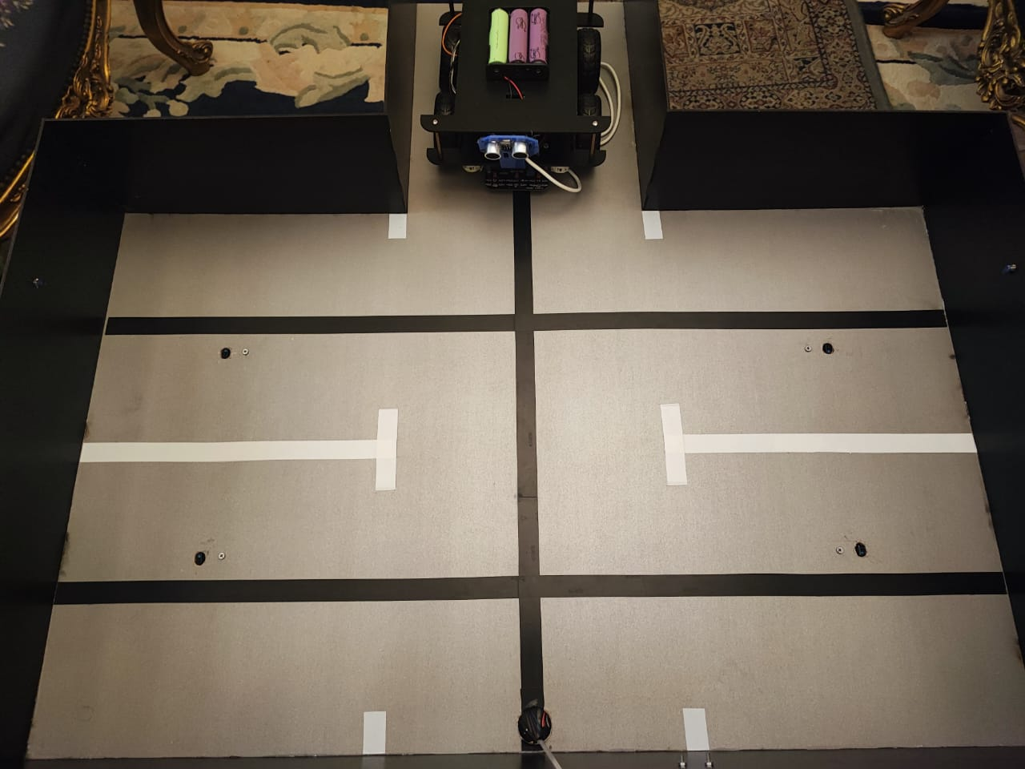

Slide 18
Cloud & Fire Base
03
To send sensor readings from an ESP32 to Firebase Realtime Database, you typically use the Firebase API along with the HTTP or HTTPS protocol for data transmission. Here's a general outline of the steps you would follow:
1. Set Up Firebase Project:
- Create a Firebase project and set up a Realtime Database in the Firebase Console.
- Obtain the Firebase project's Web API Key.
2. Include Required Libraries
- In your ESP32 code, include the necessary libraries to perform HTTP(S) requests. You might use libraries like WiFiClientSecure

Slide 19
3. Connect to Wi-Fi
- Configure your ESP32 to connect to your local Wi-Fi network using the appropriate library.
4. Craft and Send HTTP(S) Request
- Formulate an HTTP(S) POST request to send data to the Firebase Realtime Database using the Firebase REST API.
- Include the Firebase Realtime Database URL and authentication parameters (API key) in the request headers.
- Include the sensor readings as JSON data in the request body.

Slide 20
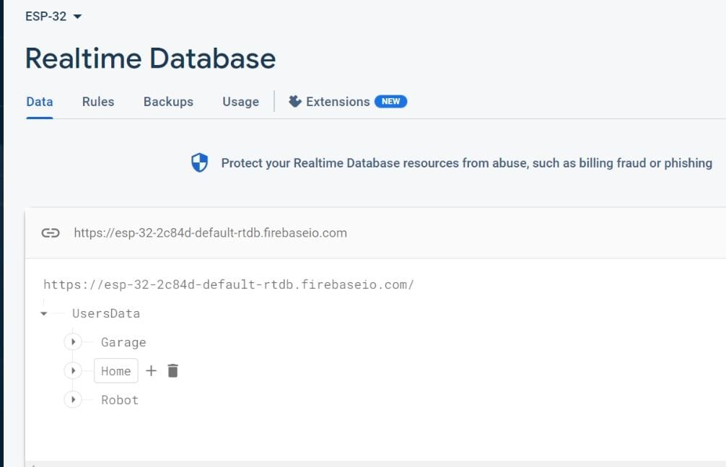


Slide 21
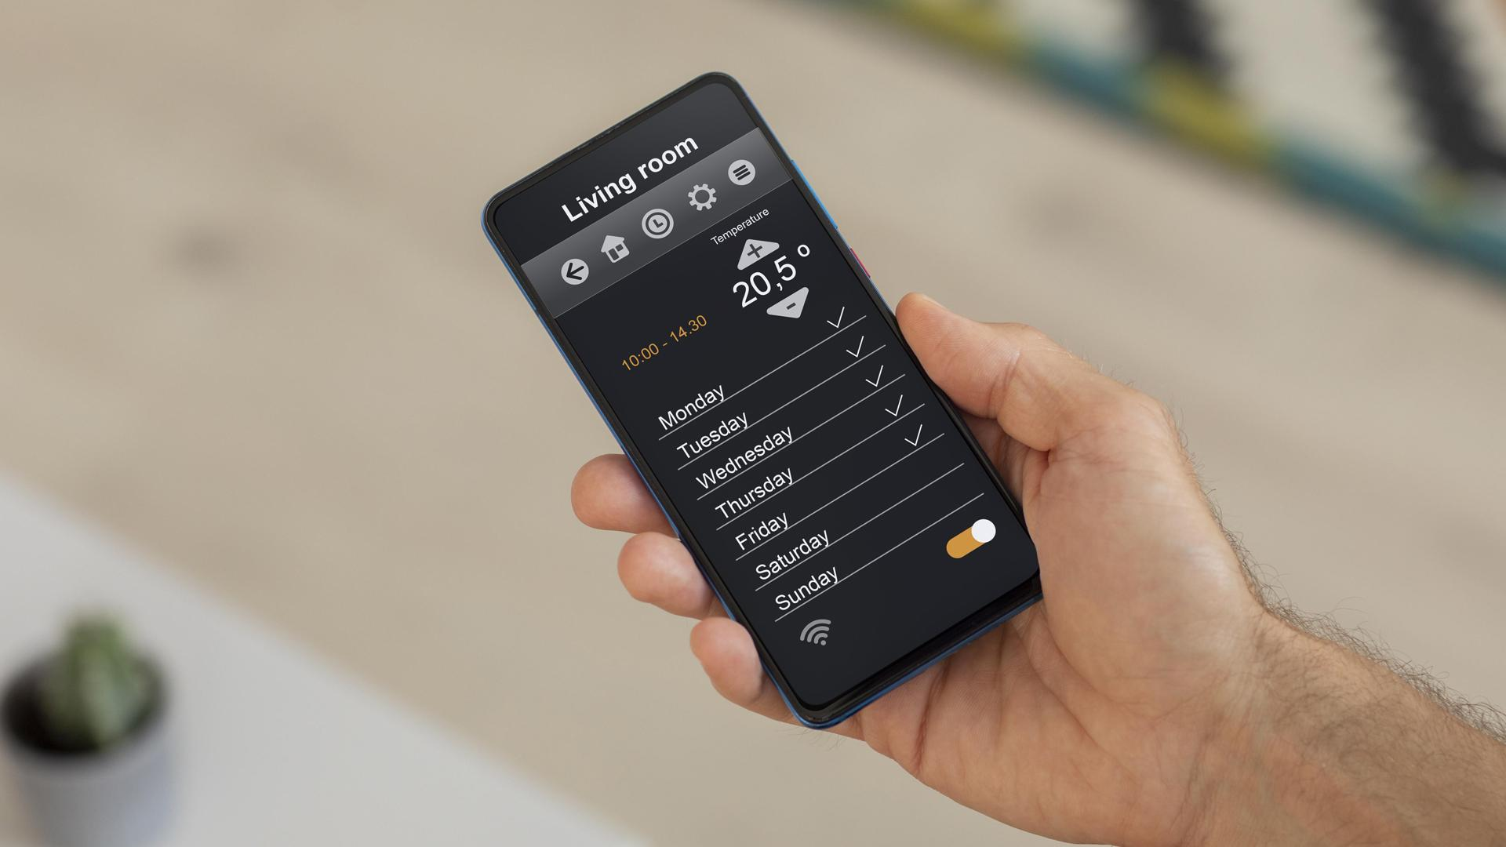
UI Application
04

Slide 22
we have seamlessly combined advanced technology to create a harmonious and intelligent living and parking experience.
1. Smart Home Control and Monitoring:
Our project doesn't stop at the smart garage; it extends to the heart of the home. With our interactive Flutter app, users can log in, sign up, and even reset their passwords if needed. A forgotten password isn't a problem anymore—the app sends a password reset link to the user's email, ensuring seamless access.
2. Home Control and Monitoring:
Once inside the app, users are presented with a choice: access the Smart Home or Smart Garage controller. In the Smart Home section, the app provides an insightful dashboard displaying sensor readings throughout the house. Users can also take control of actuators, optimizing the living environment.

Slide 23
3. Smart Garage Management:
Turning our attention to the Smart Garage, the app offers an equally intuitive interface. Users gain insights into available parking spaces, ensuring they never waste time searching for a spot. Through real-time communication with Firebase, users are always presented with the most accurate information.
4. Seamless Car Parking:
With a few taps, users can instruct their car to autonomously navigate and park itself in an available spot within the Smart Garage. This fusion of smart car technology and the garage's infrastructure is orchestrated through Firebase, creating a seamless experience.
5. Advantages of the System:
- Efficiency: Say goodbye to parking headaches. Our integrated solution ensures parking is a breeze.
- Automation : From controlling the home environment to directing your car, automation takes center stage for a convenient lifestyle.
- Accessibility: Through the app, users can manage both their living space and parking from anywhere, at any time.

Slide 24
